Slide 1
5.3 Agentic AI
Teoh Teik Toe
ITOM/NBS
ttteoh@ntu.edu.sg
97905202

Slide 2



Whatsapp: 65-97905202
Wechat: TeohTeikToe
LinkedIN https://www.linkedin.com/in/teohteiktoe

Slide 3
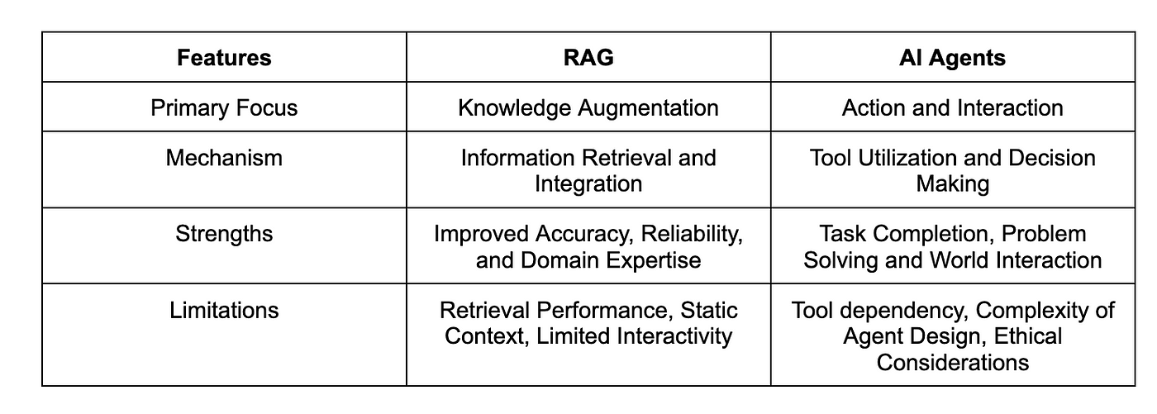
RAG vs AI Agent

Slide 4
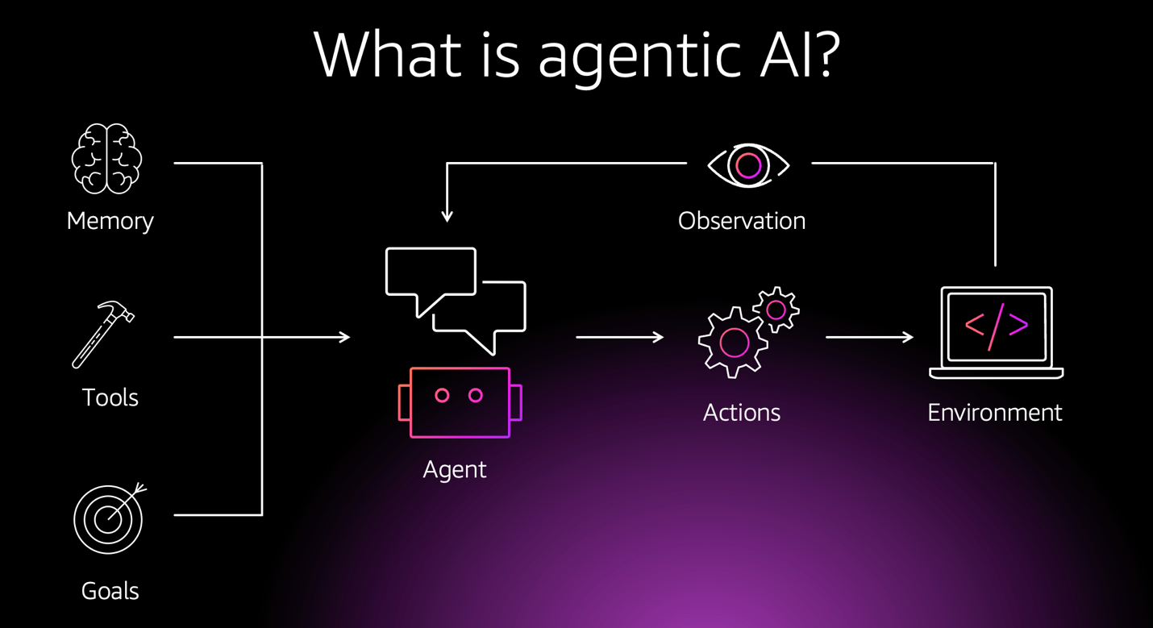
What is Agentic AI?
Agentic AI is a new paradigm where an AI system can autonomously plan, act, and reason to achieve a complex goal.

Slide 5
Non-Agentic AI vs Agentic AI
Feature | Non-Agentic AI | Agentic AI
Core Function | Prediction & Classification (Closed System): Answers a single, defined question based on learned patterns from a static dataset. | Reasoning & Action (Open System): Achieves a complex, multi-step goal by planning, sequencing decisions and using tools to interact with the external world.
Data & Knowledge | Static: Relies solely on its training data. Cannot access new information unless manually retrained. | Dynamic: Uses tools (e.g., a web search, API calls) to access real-time, external information. It can "look up" facts and stay current.
Autonomy | Passive & Reactive: A user provides input, and it provides an output. It cannot decide to take a new action or acquire new information on its own. | Proactive & Autonomous: The LLM acts as a "brain," deciding which tools to use and in what order to accomplish a goal, without constant human oversight.
Analogy | A Search Engine: Retrieves and presents information but does not decide what to do with it | An Research Assistant: Understands a high-level goal, plans the sequence of steps, searches for information, and synthesizes answers to solve the problem

Slide 6
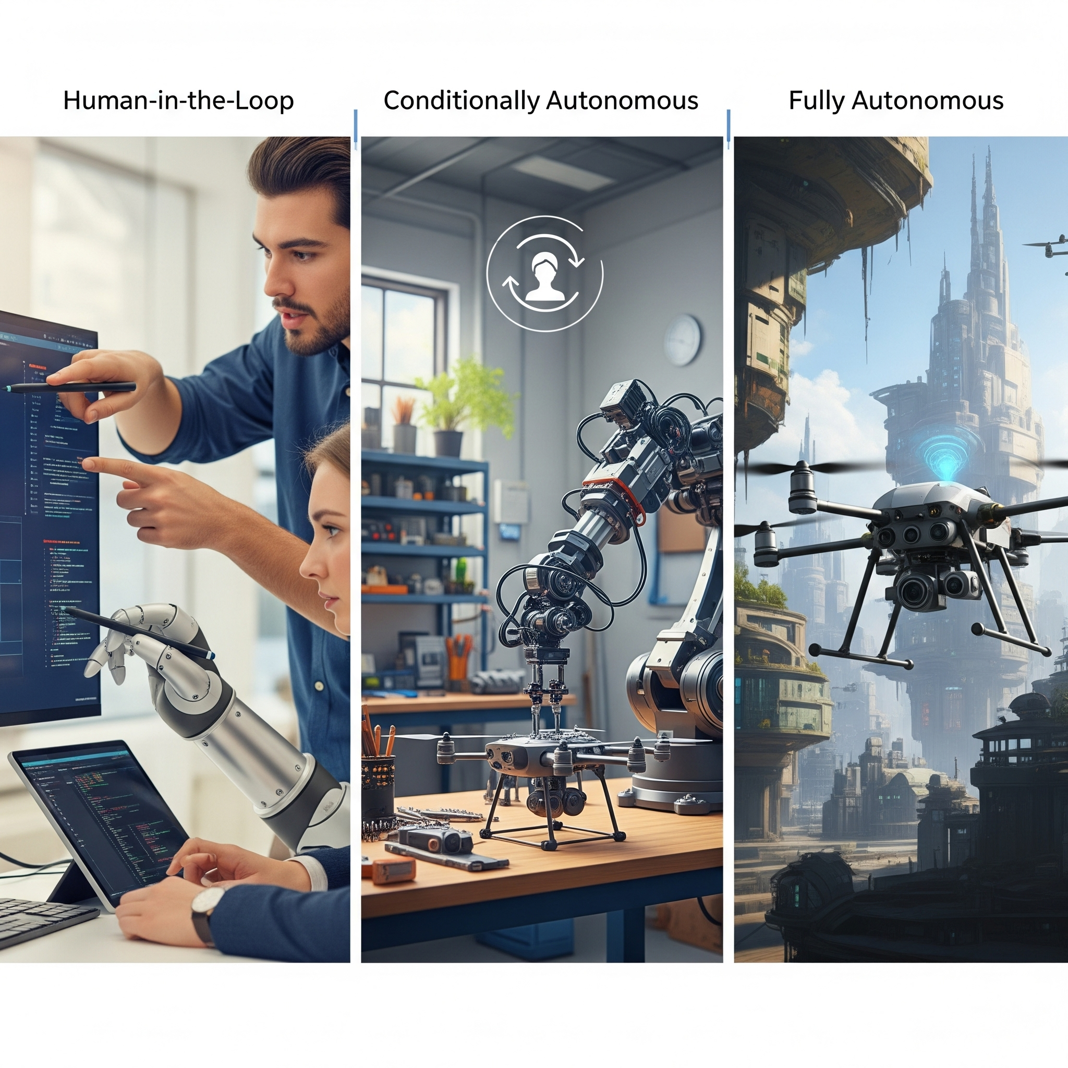
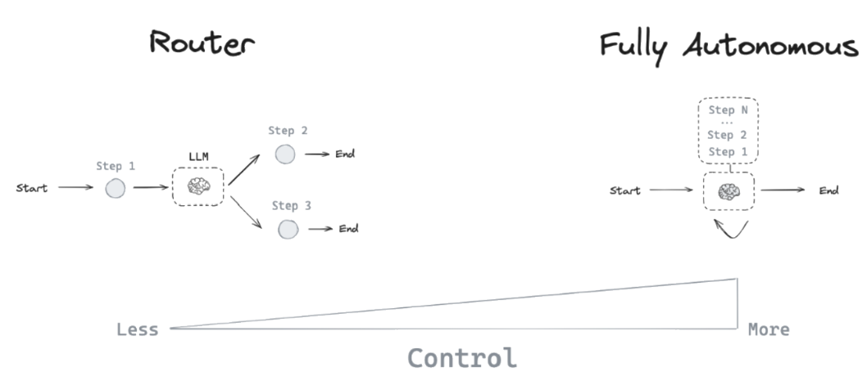
Agents Architectures (AI Autonomy)

Slide 7
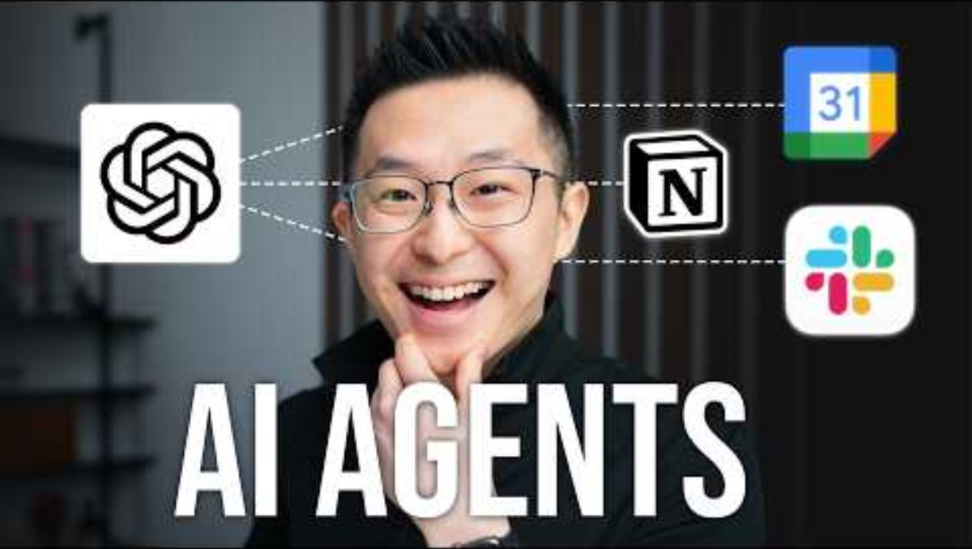
Agentic AI Explained

Slide 8
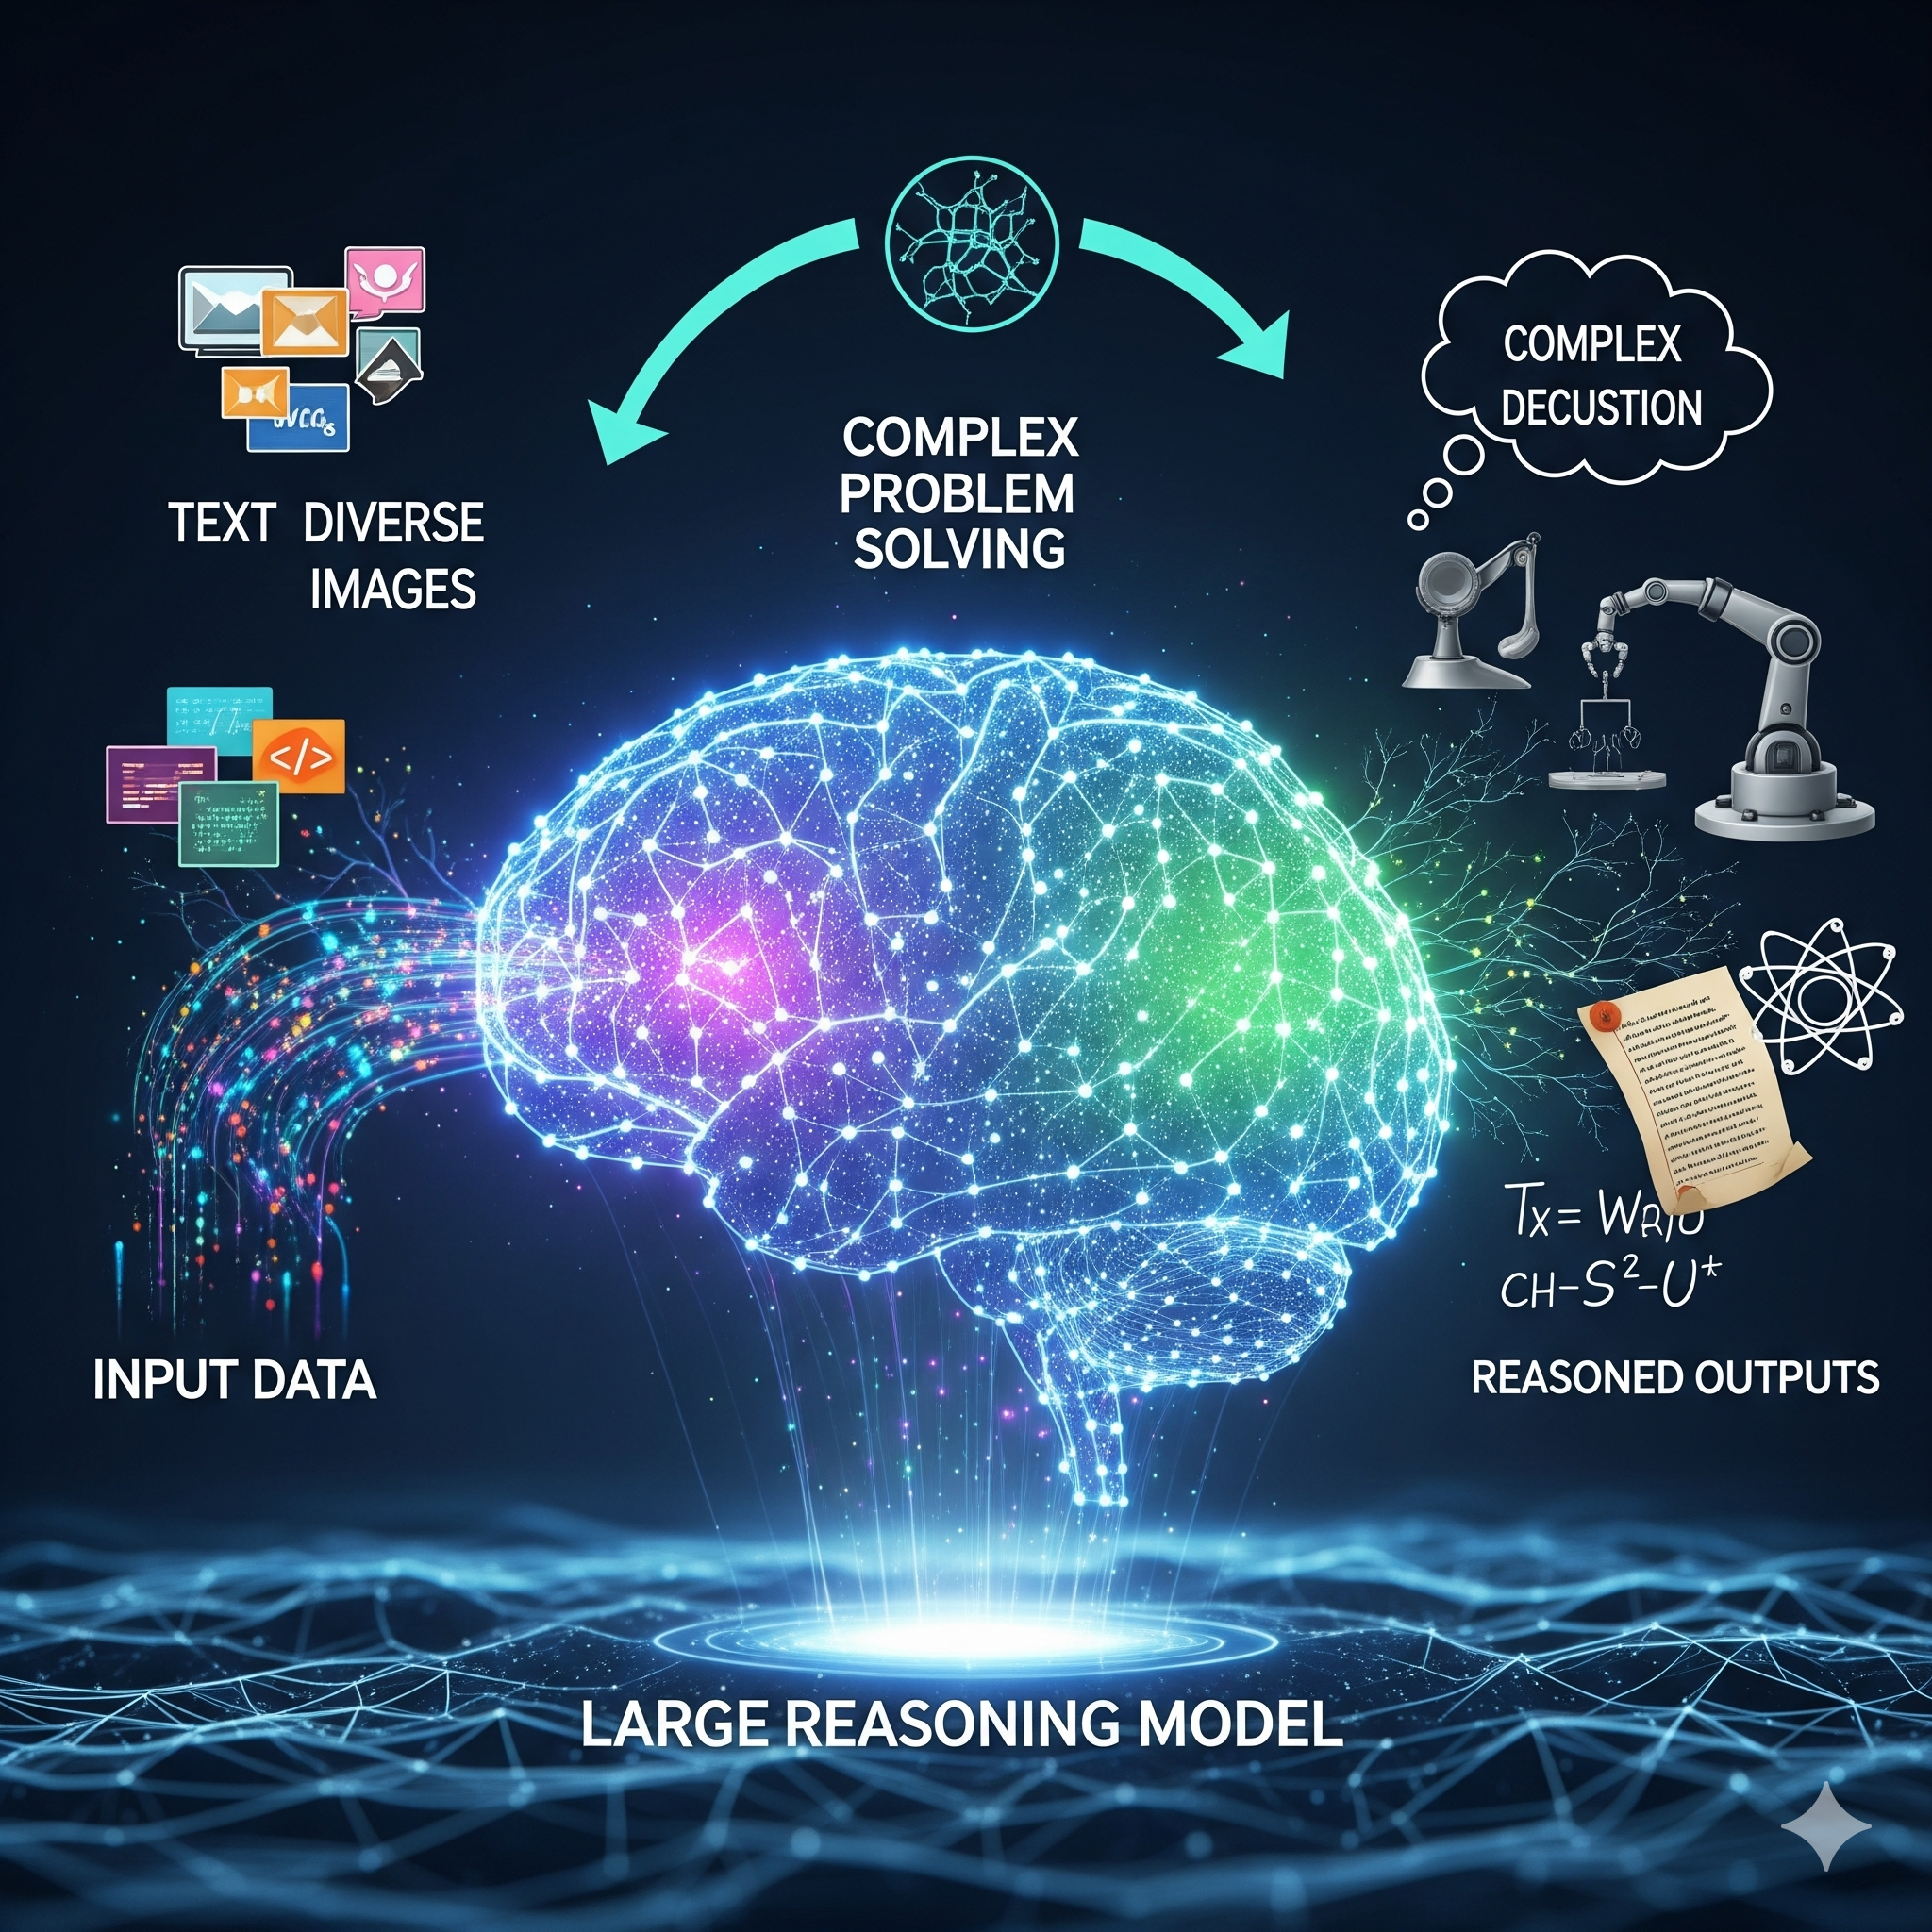
Large Reasoning Models (LRM)
A LRM is the "brain" of an AI agent. It uses NLP combined with reasoning capabilities.
LRMs use a combination of training methods and prompt strategies to enhance the reasoning capabilities of LLMs:
Enriched reasoning datasets
Reinforcement learning (RL)
Human Feedback (RLHF)
Prompt Engineering
Chain-of-thought (CoT) Prompting

Slide 9



Agentic Frameworks Overview
Framework | Best For | Philosophy | Learning Curve
CrewAI | Quick, role-based, sequential tasks. | "A team of specialists." | Low
AutoGen | Collaborative, free-form conversations. | "A chat room for AI." | Medium
LangChain (LangGraph) | Complex, stateful, custom workflows. | "A state machine for agents." | High (but powerful)
Further Readings: 1. CrewAI, 2. AutoGen, 3. LangGraph

Slide 10
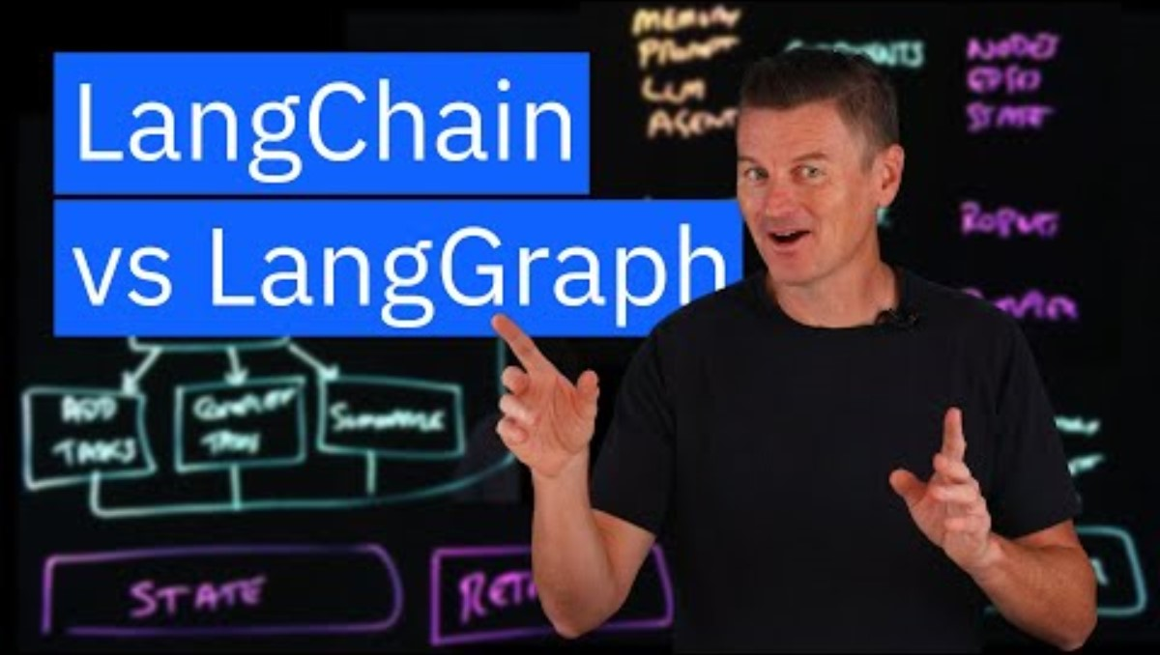
LangChain and LangGraph Explained

Slide 11
Other Notable Agentic Frameworks
LlamaIndex
Primarily a data framework for Retrieval-Augmented Generation (RAG). Ideal for agents that must reason over vast, unstructured data sources like documents and knowledge bases.
Semantic Kernel
Developed by Microsoft for integrating AI into existing enterprise applications. It is a strong choice for hybrid workflows that combine AI and native code, with a focus on security and scalability.
MetaGPT
A unique framework that simulates a full software development team. It uses a hierarchical model of collaborating agents with specific roles (e.g., Product Manager, Engineer) to automate complex, multi-step tasks from a single prompt.
Further Readings: 1. LlamaIndex, 2. Semantic Kernel, 3. MetaGPT

Slide 12
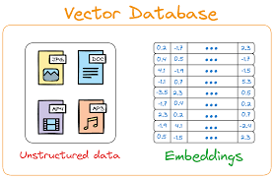
Vector Database

Slide 13
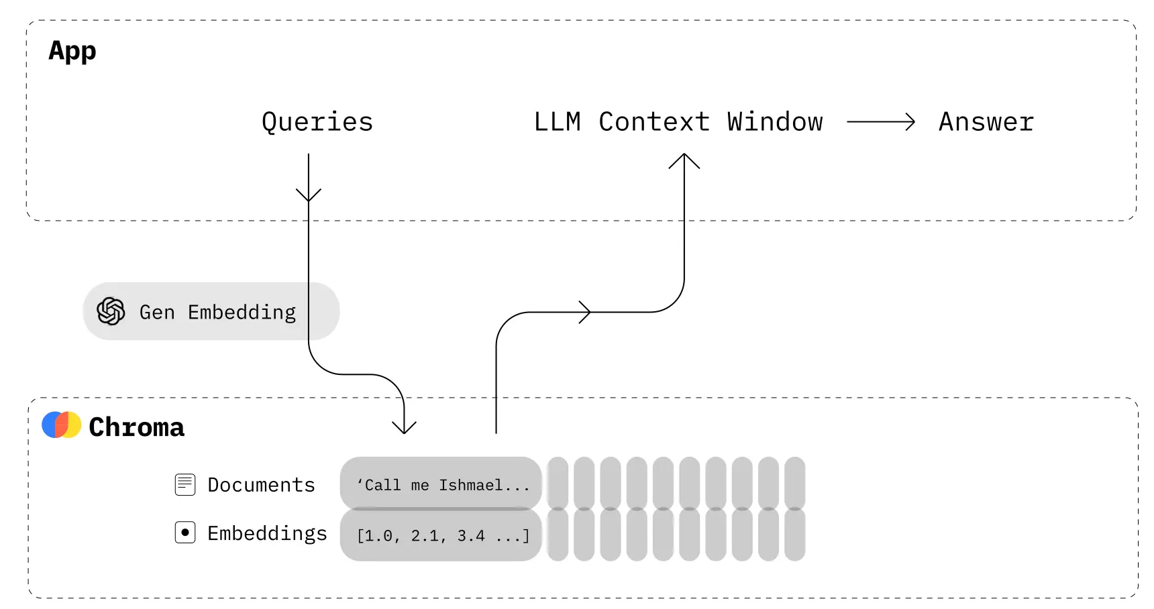
ChromaDB

